Slide 1

Forecasting Renewable Energy Production: A Time Series Approach
A Project by
Jani Shariff Shaik

Slide 2
Introduction to Renewable Energy Forecasting
The goal of this project is to forecast monthly renewable energy production.
Accurate energy production forecasts are critical for efficient grid management and policy-making.
Focused on applying advanced time series methodologies (ARIMA, SARIMA) to build robust predictive models.

Slide 3

"What Are We Solving?"
Challenge: Variability in renewable energy production due to weather conditions and other external factors.
Objective: Develop a reliable forecasting model to predict future energy production trends.
Impact: Improves planning for energy storage, grid stability, and resource allocation.

Slide 4

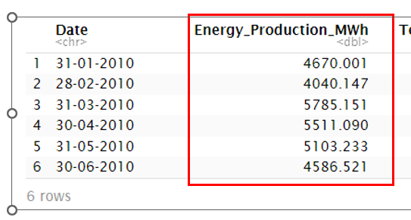
Data Used in the Project
Data Overview:
Number of Time Points: 132.
Frequency: Monthly (12).
Time Range: January 2010 to December 2020 (10 years).
Primary variable of interest: Energy Production (MWh).

Slide 5
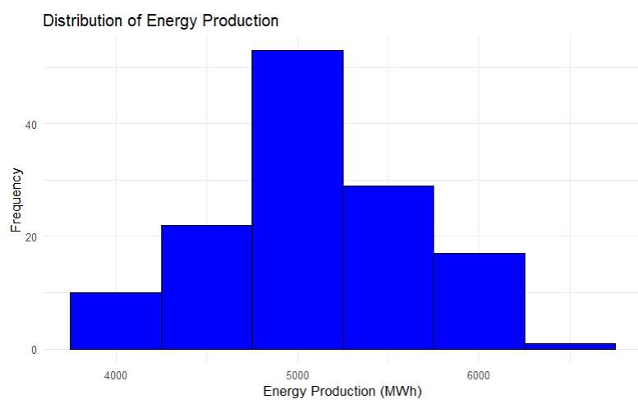
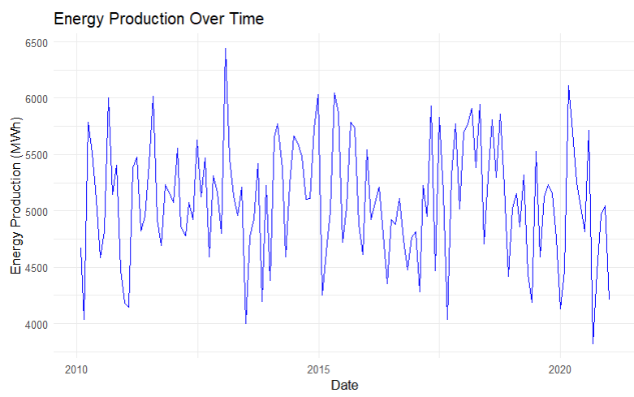
Inspection Summary and Observations
Inspection Results:
No missing values in the dataset.
Outlier analysis revealed no significant anomalies.
Energy production data appears consistent and well-distributed.
Line Plot Insights:
The line plot highlights seasonal variations in energy production.
Peaks and troughs indicate cyclical production changes over time.
Clear periodicity is evident across years.
Histogram Insights:
Majority of the values fall between 4500 MWh and 5500 MWh.
The distribution is slightly skewed towards higher energy production values.
Very few extreme values beyond 6000 MWh.

Slide 6
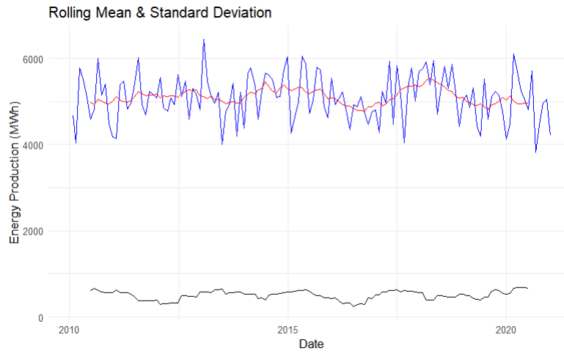
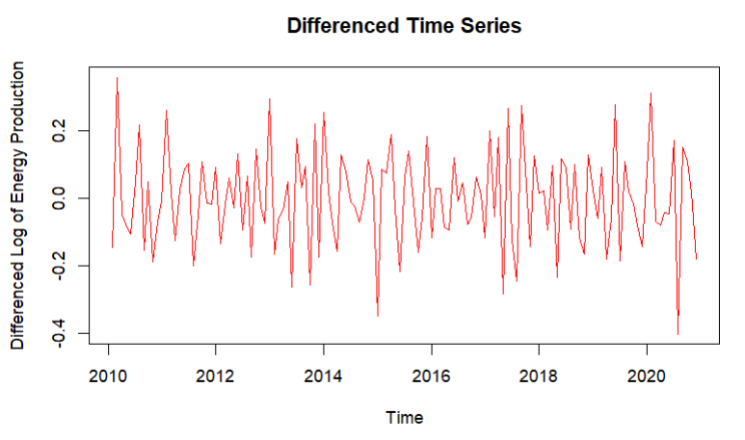

Data Preprocessing Steps
Date Conversion:
Transformed Date to proper format and arranged data chronologically.
Seasonality Strength:
Minimal seasonality detected with strength: 2.32e-09 (calculated via decomposition).
Stationarity Check:
Initial ADF test p-value: 0.045 (non-stationary data).
Applied log transformation and differencing to achieve stationarity.
Rolling Statistics:
Rolling mean and standard deviation confirmed stabilization post-transformation.

Slide 7
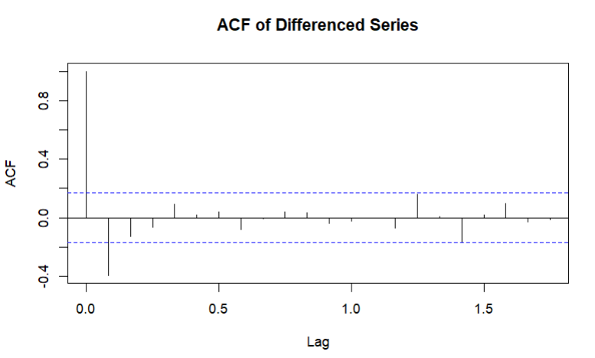
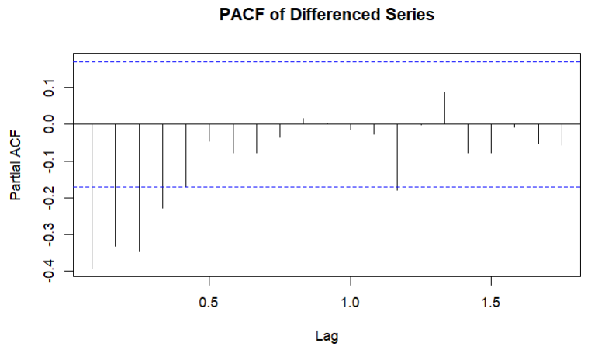
ACF And PACF Analysis
Key Observations:
ACF:
Rapid decline after lag 1, suggesting the need for moving average (MA) terms.
No clear seasonality detected.
PACF:
Significant spike at lag 1, indicating the need for autoregressive (AR) terms.
Conclusions:
ARIMA(1,1,0) model is suitable for the data.
Differencing (D=1) achieved stationarity.

Slide 8

ARIMA and SARIMA Models - Model Selection
Grid Search for ARIMA Parameters:
Automated search performed to identify the best combination of parameters (p,d,q).
Best Parameters Identified: p=0, d=2, q=3.
SARIMA Model:
Incorporates seasonality alongside ARIMA components, suited for data with periodic patterns.

Slide 9
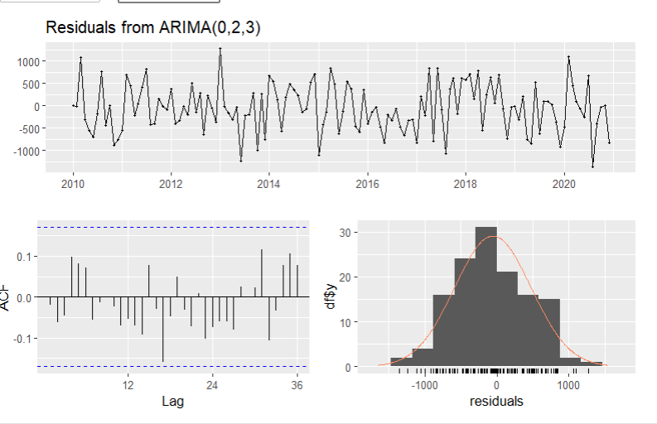
ARIMA - Model Fitting
ARIMA Model (0, 2, 3):
Coefficients:
ma1=−1.8463, ma2=0.6973, ma3=0.1511
Performance Metrics:
AIC = 2024.63, BIC = 2036.1
RMSE = 531.49, MAPE = 8.63%
Residual Diagnostics:
Ljung-Box Test p-value = 0.721 (indicating no significant autocorrelation in residuals).

Slide 10
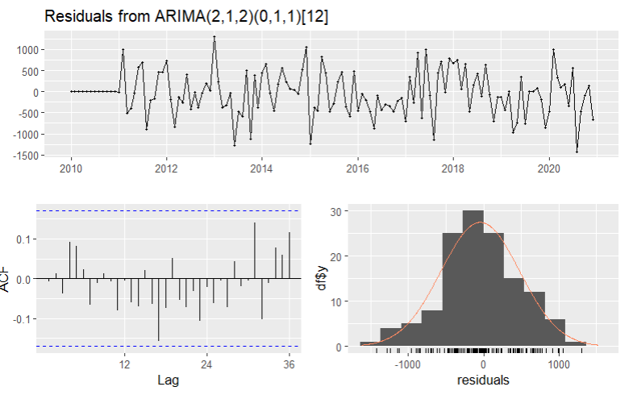
SARIMA - Model Fitting
SARIMA Model (2, 1, 2)(0, 1, 1)[12]:
Coefficients:
ar1=0.1366, ar2=−0.104, ma1=−0.9993, ma2=0.0519, sma1=−0.9961
Performance Metrics:
AIC = 1883.11, BIC = 1899.78
RMSE = 522.18, MAPE = 8.02%
Residual Diagnostics:
Ljung-Box Test ppp-value = 0.753 (no significant autocorrelation in residuals).
Conclusion: SARIMA (2, 1, 2)(0, 1, 1)[12] outperforms ARIMA by accounting for seasonality, with better metrics (lower AIC, BIC, and RMSE).

Slide 11
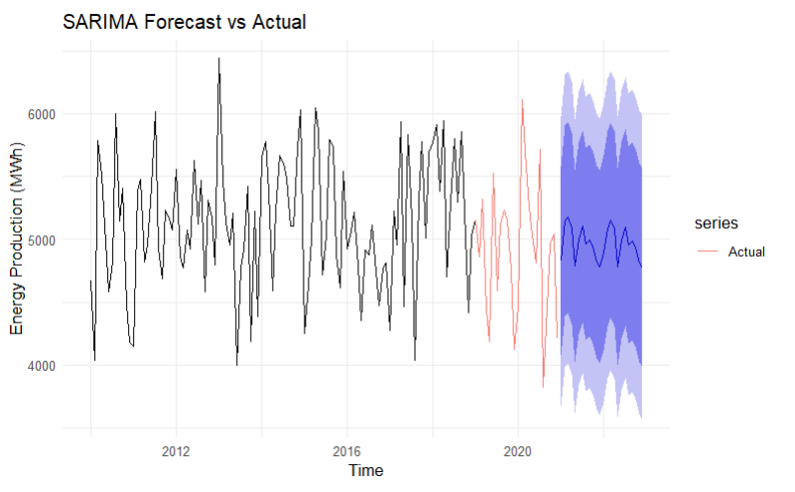
Forecasting and Evaluation
1. SARIMA Forecast vs Actual:
Objective: Evaluate the SARIMA model's forecasting ability by splitting data into training (2010–2018) and testing (2019–2020).
Visualization:
The black line represents the training data.
The red line shows actual values from the test set.
The blue-shaded region represents the forecast with confidence intervals.
Key Observations:
The SARIMA model aligns closely with actual test data.
Prediction intervals (blue region) capture the variability in energy production.

Slide 12
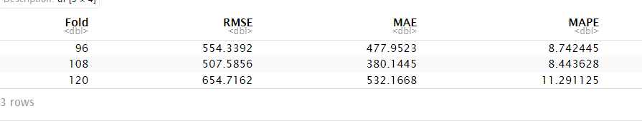
Cross-Validation Results
Objective: Evaluate SARIMA model's robustness using rolling-origin cross-validation.
Setup:
Initial training window: 96 months (8 years).
Forecast horizon: 12 months.
Step size: 12 months (1 year).
Key Metrics:
Average Errors Across Folds:
RMSE: 572.21
MAE: 463.42
MAPE: 9.49%
Conclusion:
SARIMA model exhibits reliable forecasting performance with low average error rates.

Slide 13
Conclusion for the Presentation
Key Takeaways:
Data Quality and Insights:
The dataset was well-structured with no missing values or significant anomalies.
Seasonal variations in energy production were observed, but seasonality strength was minimal.
Stationarity and Transformation:
Stationarity was achieved through log transformation and differencing.
Rolling statistics confirmed the stability of the transformed data.
Model Selection and Performance:
ARIMA(0,2,3) and SARIMA(2,1,2)(0,1,1)[12] were built and evaluated.
SARIMA outperformed ARIMA due to its ability to handle seasonality, achieving lower AIC, BIC, and RMSE values.
Forecasting Evaluation:
The SARIMA model demonstrated strong predictive performance, closely aligning with actual test data and capturing variability through confidence intervals.
Cross-validation results confirmed the model's robustness with low error metrics (RMSE: 572.21, MAE: 463.42, MAPE: 9.49%).

